Slide 1

Building Azure Search Apps
Notes:
Who am I?
* Joe Zack, dev, podcaster
* Security Logging and Analytics
What is this about?
Azure Search
Search Engine Overview
Code through an App
Tour of advanced features
Search engine driven applications
I’ve used search engines in eCommerce for a long time, but recently I spent some time taking another look at them to try and figure out if they were an appropriate solution for something I was doing at work.
While I was doing that research, I came up with a few different archetypes that I thought fit really well with search engines do and so I thought it would make for a cool talk!
Define the problem
How they solves it
Demonstrate 3 types of apps
Go do it!
https://www.kisspng.com/png-squirtle-pikachu-pokmon-blastoise-charmander-squ-4321888/

Slide 2
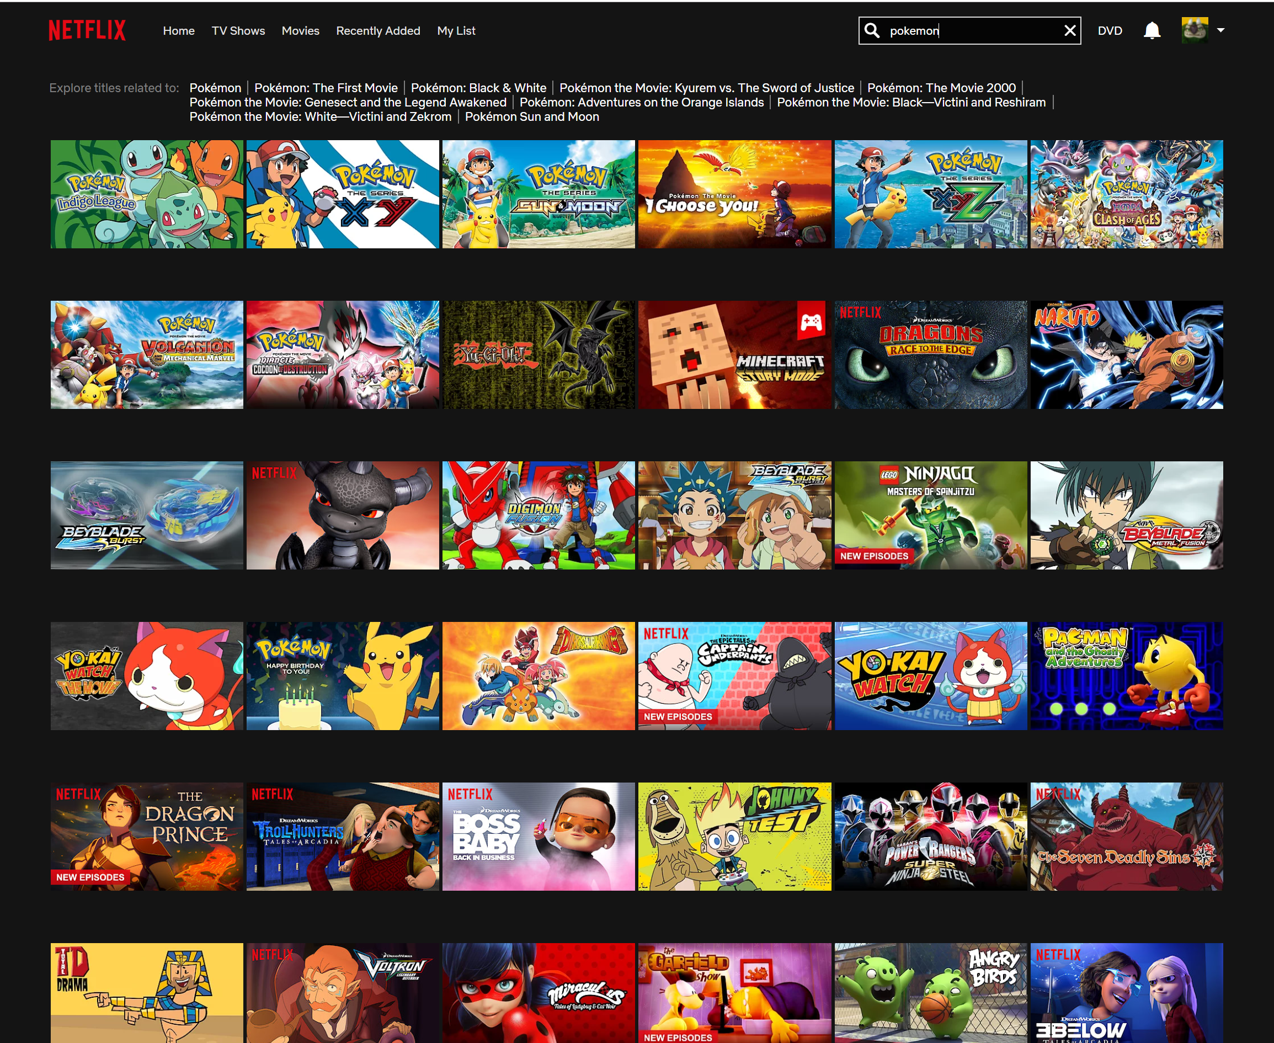
Notes:
Search is a core tenet of the modern usability
It’s a huge part of how we interact with world
Google obviously, but think about how important search is to other experiences: Cortana, Spotlight, Alexa
You can hardly use the telephone, listen to music, buy underwear, or even watch “tv” without some sort of search. Imagine explaining that to your grandparents grandparents!
But…we humans aren’t very good at it.
We typo, don’t know what we’re looking for
As a dev, I’m really interested in building tools that ease the interactions between humans and data and search is a huge part of that.
--
How are these interactions are built
https://ardorseo.com/blog/how-many-google-searches-per-day-2018/
https://www.scrapehero.com/many-products-amazon-sell-january-2018/
https://stackexchange.com/performance

Slide 3
https://www.eetimes.com/author.asp?section_id=36&doc_id=1330462
Notes:
Data is growing exponentially
My customers expect more out of my software
Tools have gotten better

Slide 4

Why search engines?
UX
DX
Scalability
Performance
Cost
Notes:
So what tools are the big dogs using?
They use search engines, highly performant, highly scalable, nosql search engines.
https://www.kisspng.com/png-arcanine-pokmon-growlithe-drawing-image-6324448/

Slide 5

Why not RDBMS?
Not designed for search
Emphasis on ACID
Poor Scalability
Notes:
First up, lets address the elephant in the room
Ultimately the apps I’m going to show you today can absolutely be built on a traditional sql databases, but YOU, the dev, are going to be doing a lot of extra work
If you want to deliver the types of search experiences that your users are used to.
Any time you spend working on common search features is time away from your problem domain.
Slowly and poorly reimplimenting features that already exist in search engines
Designed specifically for common search use cases
Relational databases are mature, robust solutions
They’re great at storing and retrieving data, and they’ve matured really well.
They’re really good at transactions
The standard argument that they don’t scale horizontally well, ”web scale”
Atomicity, Consistency, Isolation, Durability
Basic Availability, Soft State, Eventual Consistency

Slide 6

Why is Azure Search?
Managed Service
REST API
Lucene Query Syntax
Notes:
It's a managed service that provides a provide restful API around a search engine
It supports basic Lucene Syntax - Apache Lucene is the most popular search technology and most search engines (like Elasticsearch or Apache Solr) still have it at the center, even though it was initially released in 1998
Because all of these engines support basic Lucene syntax, it means anything you write for Azure Search should be easy to move over to one of the others
Lets go take a look!

Slide 7
Is it worth it?
Notes:
There is one huge pro to SQL, you’ve probably already need it for some other reason
why extend your technical footprint?
That’s a good question to ask
A search engine really needs to bring a LOT of value in order for you to consider adding it to your solution
…so, from here on – lets focus on that what we get
So you can figure out if the overhead is worth it

Slide 8
What we saw
Text Search
Stop Words
Stemming
Synonyms
Fuzzy Searching
Relevance tuning
Import
Aggregation/Filtering
Aggregates
Auto-Bucketing
Ranges
One-To-Many
Auto Complete
Monitoring
Streaming data
Dashboards
Visualizations
Index Management
Notifications
Notes:
Quick shot of what I got out Elasticsearch for the demo apps
These are common features of search engines, because it’s the kind of stuff that we (as a human) expect to just happen
The ways we interact with a search engine are really basic: Either you type in the text box, or maybe you click a few check boxes
Wanted to get all these points on one slide to show you that despite the simple interface, and simple apps, there can be a lot going on.

Slide 9
Advanced Features
Notes:
There is one huge pro to SQL, you’ve probably already need it for some other reason
why extend your technical footprint?
That’s a good question to ask
A search engine really needs to bring a LOT of value in order for you to consider adding it to your solution
…so, from here on – lets focus on that what we get
So you can figure out if the overhead is worth it

Slide 10
What we didn’t’ see
Text Search
Stop Words
Stemming
Synonyms
Fuzzy Searching
Relevance tuning
Import
Aggregation/Filtering
Aggregates
Auto-Bucketing
Ranges
One-To-Many
Auto Complete
Monitoring
Streaming data
Dashboards
Visualizations
Index Management
Notifications
Notes:
Quick shot of what I got out Elasticsearch for the demo apps
These are common features of search engines, because it’s the kind of stuff that we (as a human) expect to just happen
The ways we interact with a search engine are really basic: Either you type in the text box, or maybe you click a few check boxes
Wanted to get all these points on one slide to show you that despite the simple interface, and simple apps, there can be a lot going on.

Slide 11
Text Search
Stop Words
Stemming
Synonyms
Fuzzy Searching
Trivial import
Notes:
I got this all with JSON!

Slide 12
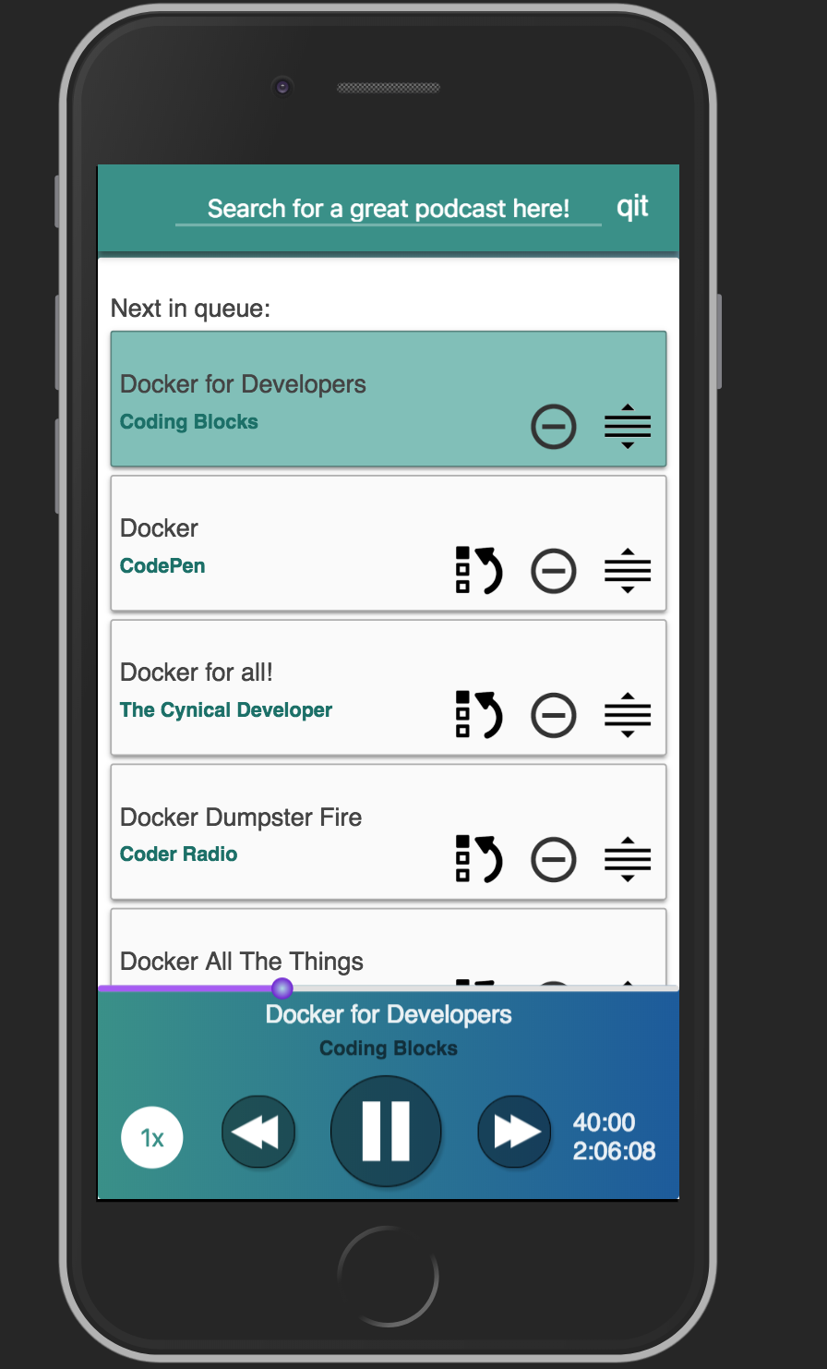
QIT.cloud
Notes:
Indexes about 7,000 episodes
Query it in about 0 seconds, rounded up
Search engine allows us to focus on UX

Slide 13
Filtering
Aggregates
Auto-Bucketing
Ranges
One-To-Many
Auto Complete
Relevance tuning
Notes:
Everything I said before, plus…

Slide 14
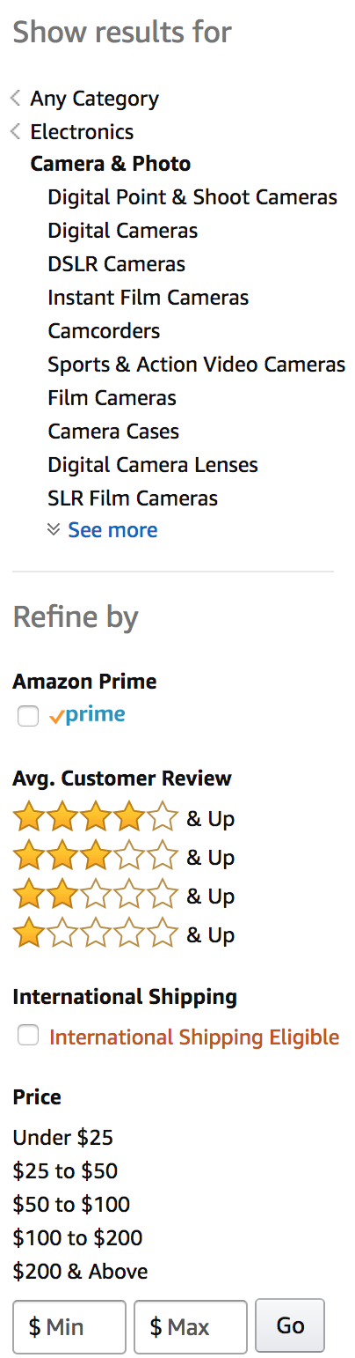
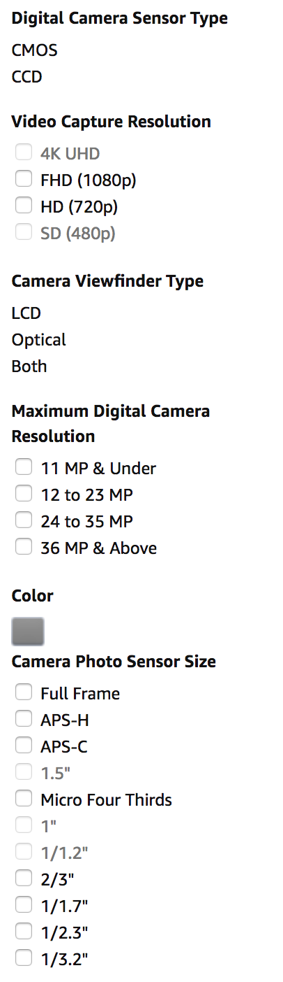
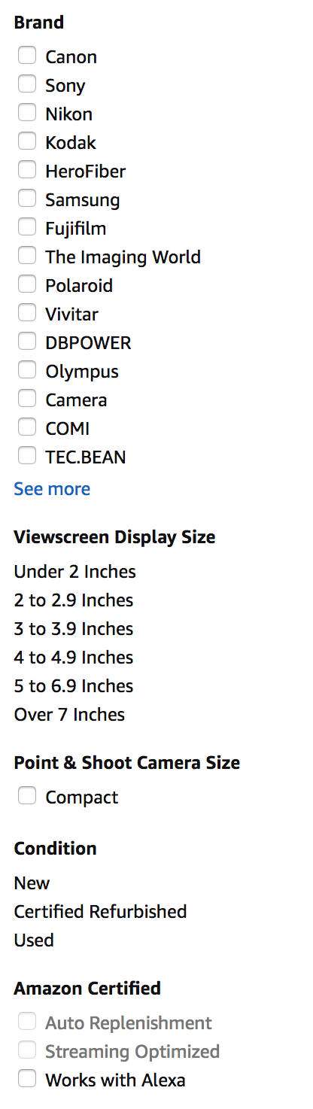
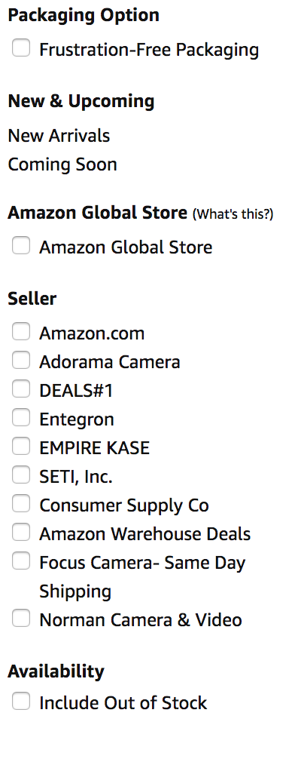
Notes:
80,000 for “camera’
In addition to the fuzzy search…
Sliced up the data in interesting ways:
One-to-Many relationships
Numeric Ranges
Custom Data

Slide 15
APM?
Dashboards / Graphs
Streaming data
Visualizations
Index Management
Notes:
Everything I said before, plus…

Slide 16
Notes:
Splunk DataDog
Difference here is
Windows 2012
Python 2.7
How does near real-time jive with the up front processing of indexes?
In practice, it’s not that slow, and most of the stuff we want to see graphed doesn’t need complex processing (synonyms, stop words, phrases)

Slide 17
Building Azure Search Apps
Notes:
Who am I?
* Joe Zack, dev, podcaster
* Security Logging and Analytics
What is this about?
Azure Search
Search Engine Overview
Code through an App
Tour of advanced features
Search engine driven applications
I’ve used search engines in eCommerce for a long time, but recently I spent some time taking another look at them to try and figure out if they were an appropriate solution for something I was doing at work.
While I was doing that research, I came up with a few different archetypes that I thought fit really well with search engines do and so I thought it would make for a cool talk!
Define the problem
How they solves it
Demonstrate 3 types of apps
Go do it!
https://www.kisspng.com/png-squirtle-pikachu-pokmon-blastoise-charmander-squ-4321888/

Slide 18

Like this talk? Check out the show!
Joe Zack
@codingblocks
Notes:
Like this talk? Check out the show!

